Slide 1
Network Programming
Game 311
Chapter 2
TCP / UDP

Slide 2
Lecture 9 (Chapter 2 & 6)
Objectives
TCP Data Transfer
Network topologies
  How should different computers be connected to each other, in the game, and what are the tradeoffs?
Implementing peer to peer
  When is this beneficial?
  How is this implemented?
Implementing client-server
  What are the specific challenges of implementing the client-server topology?
  What is server Authority?

Slide 3

Problems with UDP
Offers no guarantees over the underlying network layer, which means it too is Unreliable
  Datagrams might arrive out of order
  Datagrams might arrive twice
  Datagrams are not guaranteed to arrive at all

Slide 4
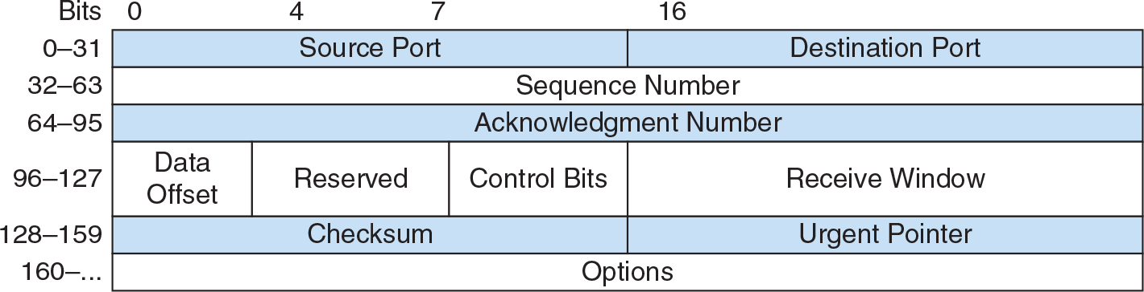
TCP: Transmission Control Protocol
“Reliable”
  Segments are received in order
  Segments are “guaranteed” to arrive

Slide 5
How Does Reliability Work
Sequence number uniquely identifies each segment.
Receiver acknowledges segments.
Sender resends unacknowledged segment.
Sequence number increases by size of segment.
Acknowledgement number is sequence number of last received segment + the size of the segment’s data.

Slide 6
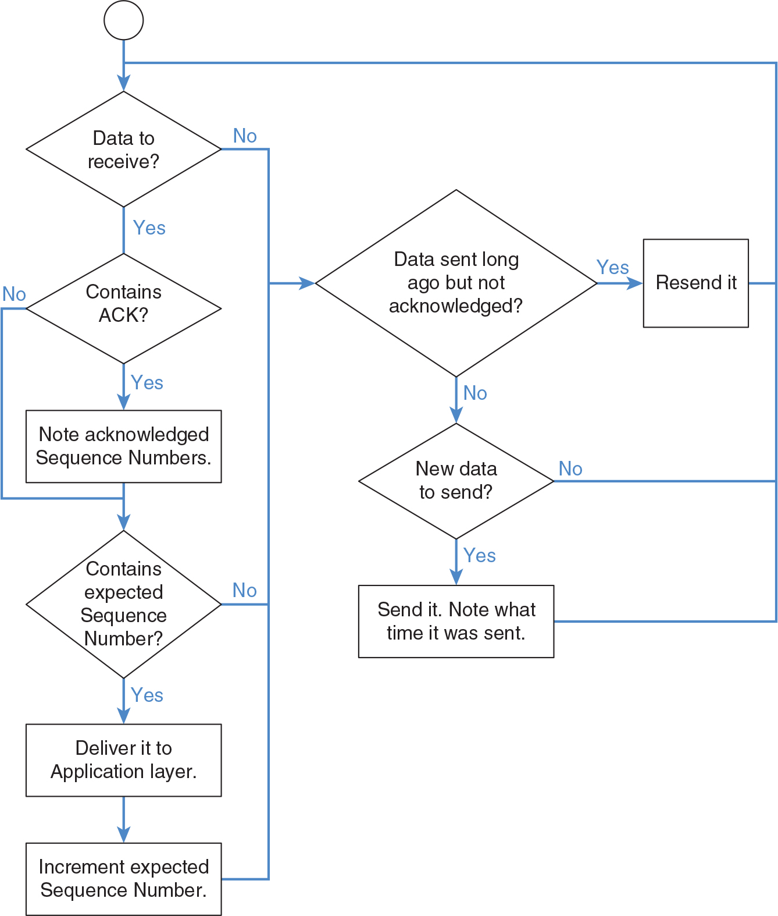
Reliability Flow

Slide 7
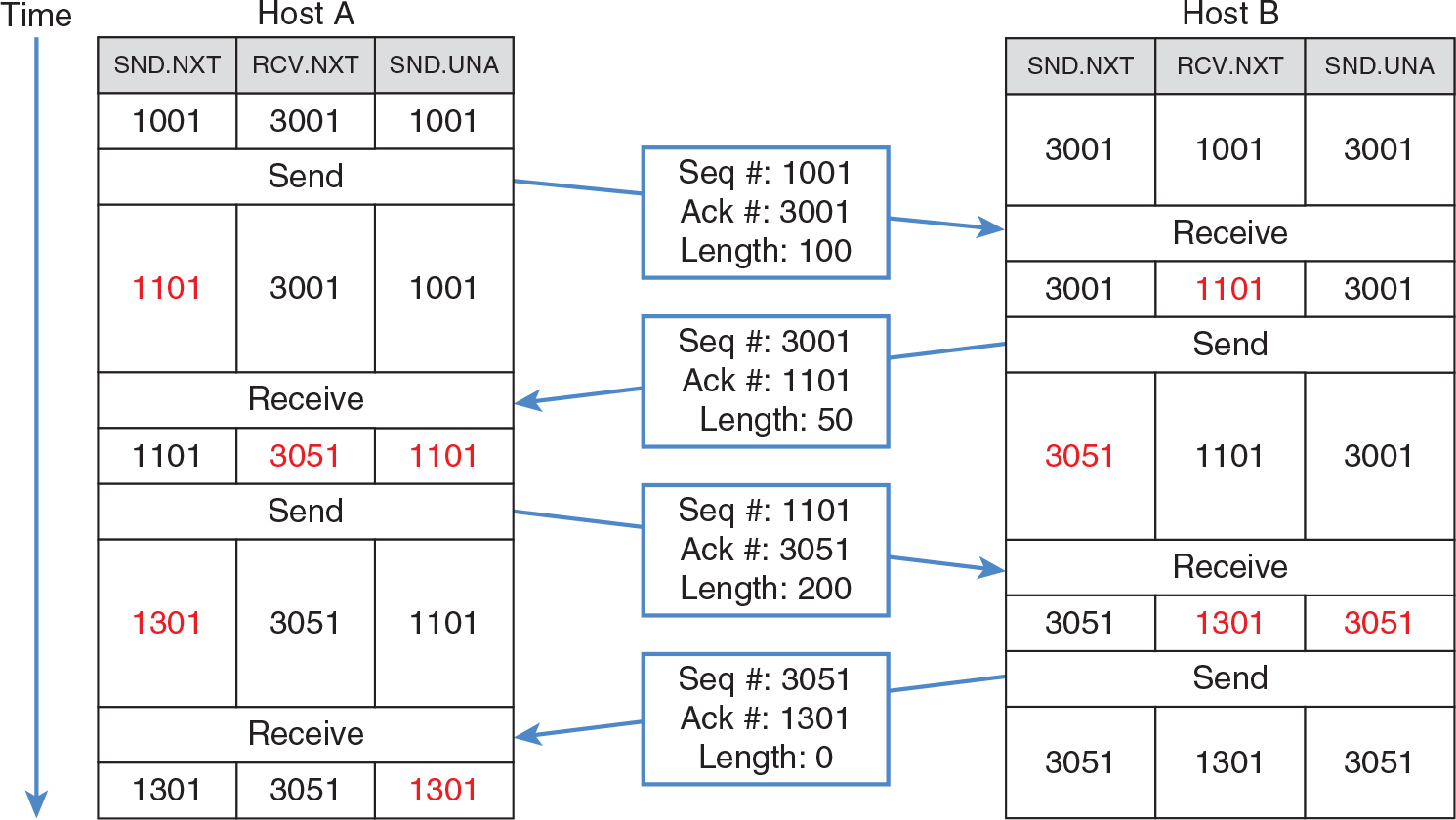
No Packet Loss

Slide 8
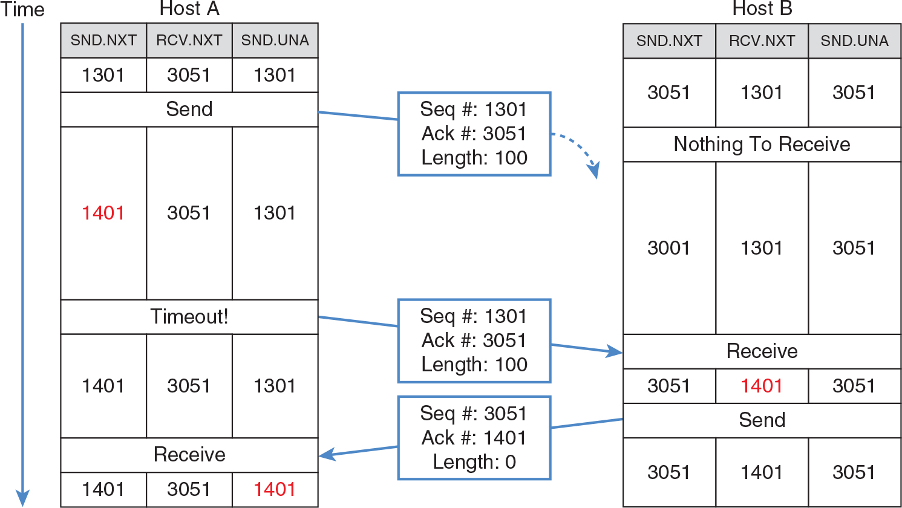
Packet Loss

Slide 9
Requirements
Buffer for segments
  So they can be re-sent (by sender)
  So they can be processed in order (by receiver)
Stateful connection
  Sequence number
  Acknowledgment number
  Buffers
  Timers

Slide 10
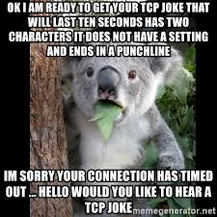
Disadvantages of TCP
Requires stateful connection
Limited by flow and congestion control
No way to send packets unreliably
No way to process received data until all intermediate data received

Slide 11
Packet Size Efficiency
Header size can add up:
  40+ bytes per packet!
  The greater the header to payload ratio, the lower the effective bandwidth.
  Send packets as big as possible:
    But avoid fragmentation; remember the MTU.
    Ethernet MTU is 1500 bytes.
    Tunnels and wrapper protocols can use up payload space.
    Keep payloads around 1300 bytes.

Slide 12
Desyncs
Desyncs is a term used for desynchronization of the execution of code in a networked game.
  Essentially the state on one client does not match the server or other clients.
  This can result in the game processing differently for different users.
    Not good.

Slide 13
Desync Options
To solve desyncs we need to ensure a few things:
  The clients both have identical codebases or versions of the game
  The gameplay processing is based of a static time and not based off execution timing
    Step timer for processing
    Synchronized delta time from server
  Events or packets don’t rely on previous events or packets.
    This one is sometimes a bit more tough to workaround.

Slide 14
Network Topologies
Which hosts send data to which other hosts
Impacts total bandwidth used by the game
Impacts latency of players experiences
Impacts method used to share a consistent game world
Impacts what the game can do
Impacts how players can and cannot cheat
Impacts how player hardware affects other players
Impacts cost to operate a game

Slide 15
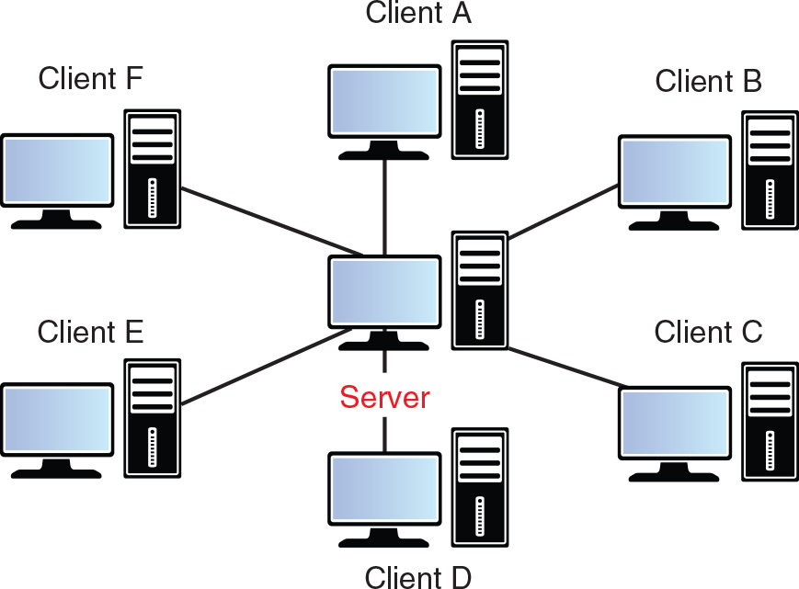
Client-Server

Slide 16
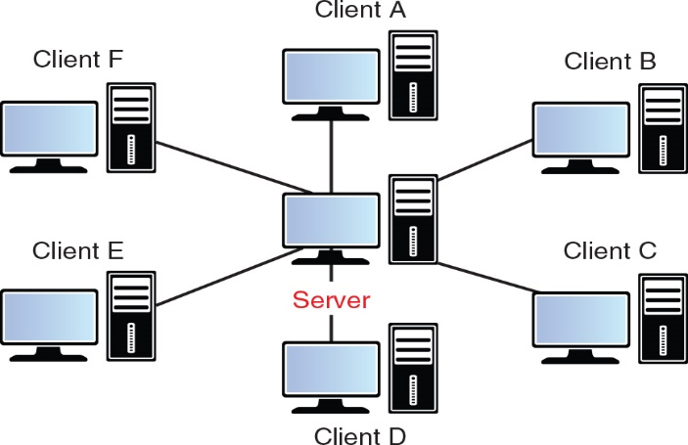
Client-Server Properties
All clients connect to only one server:
  O(2n) connections total
    Server: O(n) connections
    Client: 1 connection
  Asymmetric requirements
    Server needs better hardware and much more upstream bandwidth than clients.
    Server needs scale as client count increases.
    Client needs remain relatively constant.

Slide 17

Types of Servers
A dedicated server is only a server process and can run on a completely separate machine than any clients.
  Many bigger games run their own servers.
A listen server involves a server that is also an active participant in the game:
  Saves developers money
  May give the player who is on the listen server an advantage in terms of latency
  May need a complex setup to support host migration (changing from one player hosting to another)

Slide 18
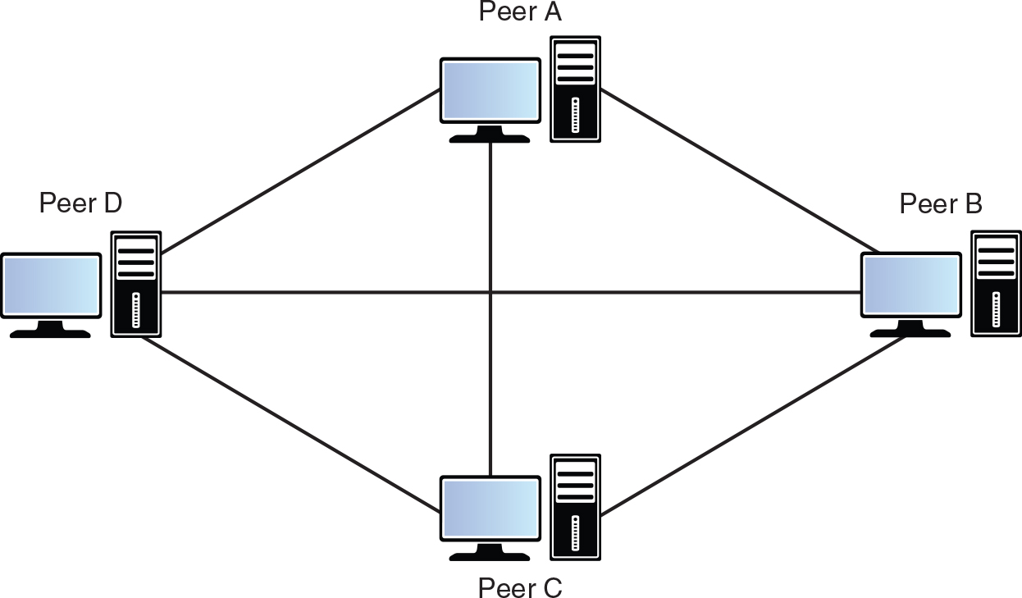
Peer to Peer

Slide 19
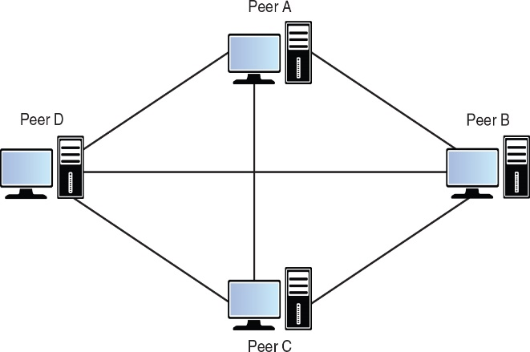
Peer-to-Peer Properties
Each computer connects to every other computer:
  O(n²) connections total
    Each peer: O(n – 1) connections
  Symmetric bandwidth requirements
    The more players in the game, the more bandwidth required.
    Each peer requires the same amount of bandwidth.
  Better latency than client-server
  Less security than client-server

Slide 20
Summary
Network topologies
  How should different computers be connected to each other, in the game, and what are the tradeoffs?
Implementing client-server
  What are the specific challenges of implementing the client-server topology?
Implementing peer to peer
  How to guarantee synchronization between peers in a deterministic lockstep simulation

